Slide 1
Movie Recommendation System using Collaborative Filtering and Reasoning
Krishna Swaroop Pamidimukkala (kp956)
LAXMAN SRIKANTH SISTA (LS1274)
ABHINAY MANNEPALLI (AM2977)

Slide 2
Motivation
Exploring different Collaborative filtering algorithms presented in the lectures and identify areas of improvement
The existing Collaborative Filtering methods lack the ability to perform a cognitive reasoning and only possess the pattern learning and matching
In fact, because recommendation is a cognition task rather than a perception task, it necessitates not only pattern learning and matching, but also cognitive reasoning
Researchers suggested Neural Collaborative Reasoning (NCR) to attain this goal, which describes the recommendation problem as a differentiable (i.e., neural) logical reasoning problem based on wisdom of crowd(i.e., collaborative)
The Key idea is to be able to:
Learning logical variables as vectors in logical embedding space
Learning logical operations as neural modules in the latent space
Notes:
Each user's behavior record is interpreted as a logical implication rule, such as (a ∨ b) ∧ ¬c → v, which indicates that the user liked item v based on his or her previous choices on a, b, and c. In this sense, each user is aware of a portion of the entire logical space, allowing collaborative logical reasoning to be conducted based on the combined information of all users to estimate the preferences of new users.
If a user had previously purchased a laptop, one would not expect the user to purchase identical laptops in the future; rather, one would expect the user to purchase additional equipment such as a laptop bag. Certain logical structures may appear in such a reasoning approach, such as (a b) c v, which suggests that if the user loves an or b but not c, he or she will most likely prefer v. An intelligent recommendation system, as a representative cognitive reasoning problem, should be able to uncover and leverage logical relationships in data in order to reason over the data for the prediction of future user behaviors.
Point 2: because a user's future behavior may not be driven solely by similarity to previous behaviors, but rather by the user's cognitive reasoning procedure about what to do next.

Slide 3
About the Data-MovieLens
The Dataset was obtained from Movielens site which is a part of Grouplens Research
There were 100K ratings/entries in the movie rating dataset
The movie ratings ranging from 1 to 5
Findings about the data.
No redundancies, missing values and No incorrect values.
Contains data authenticity
All the data features are independent and positively skewed and none of the columns are normally distributed

Slide 4
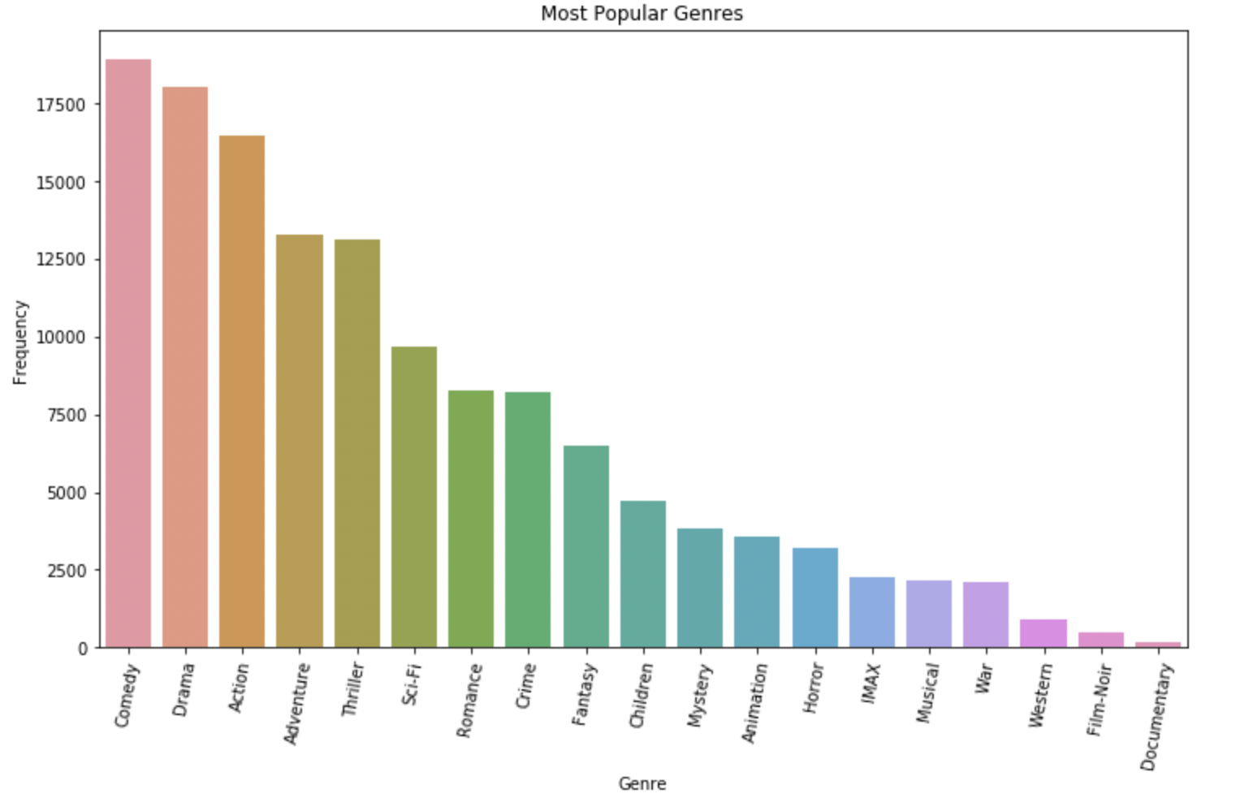
Exploratory Data Analysis-1

Slide 5
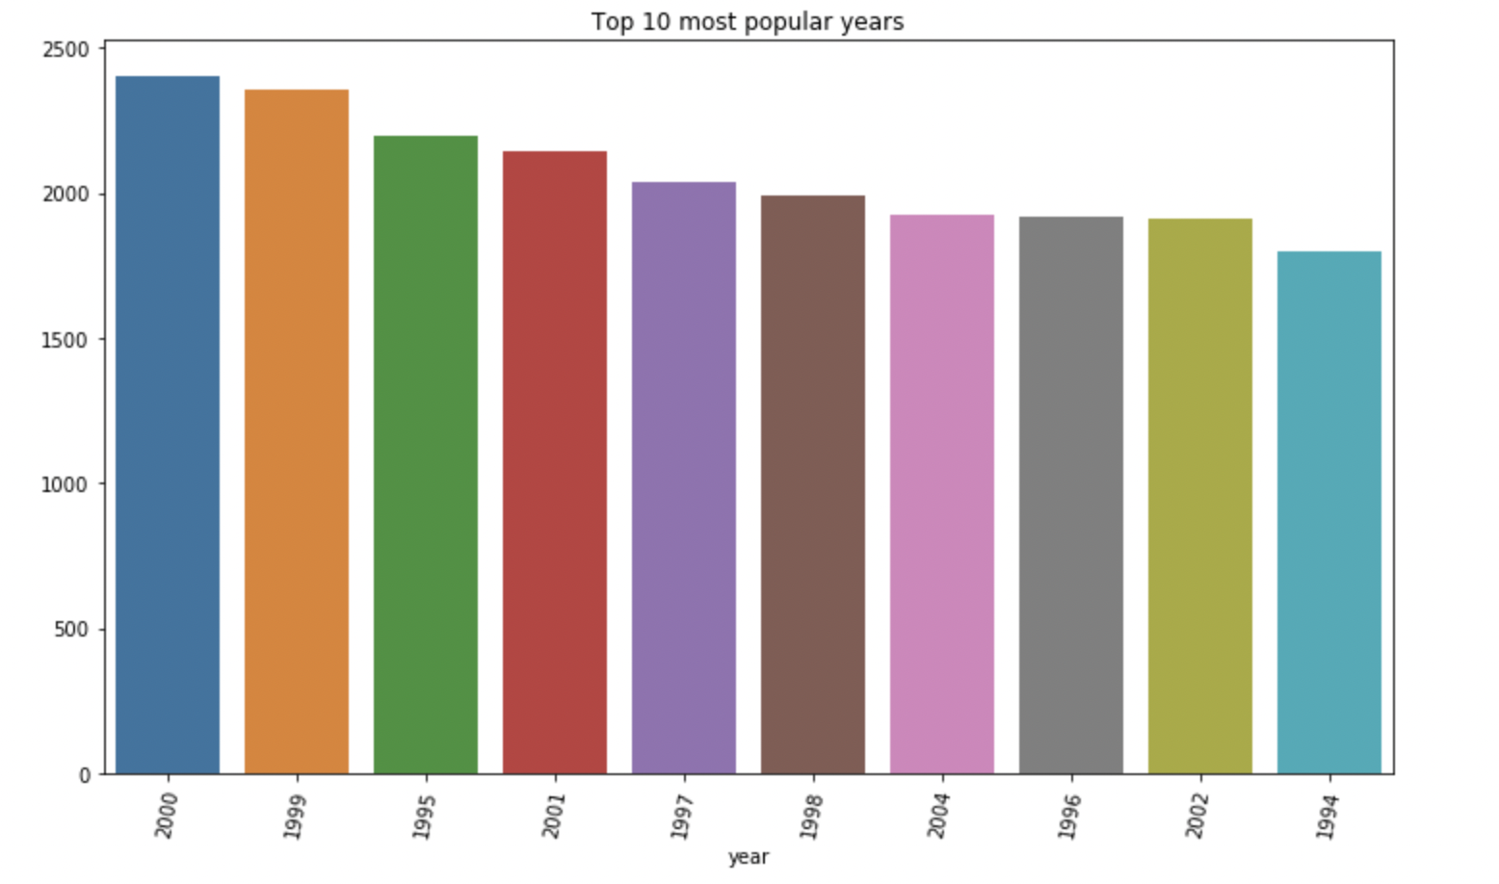
Exploratory Data Analysis-2

Slide 6
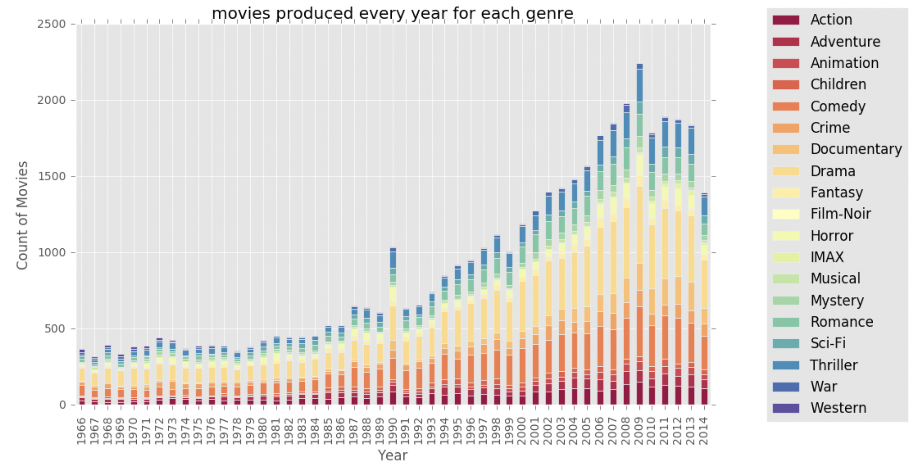
Exploratory Data Analysis-3

Slide 7
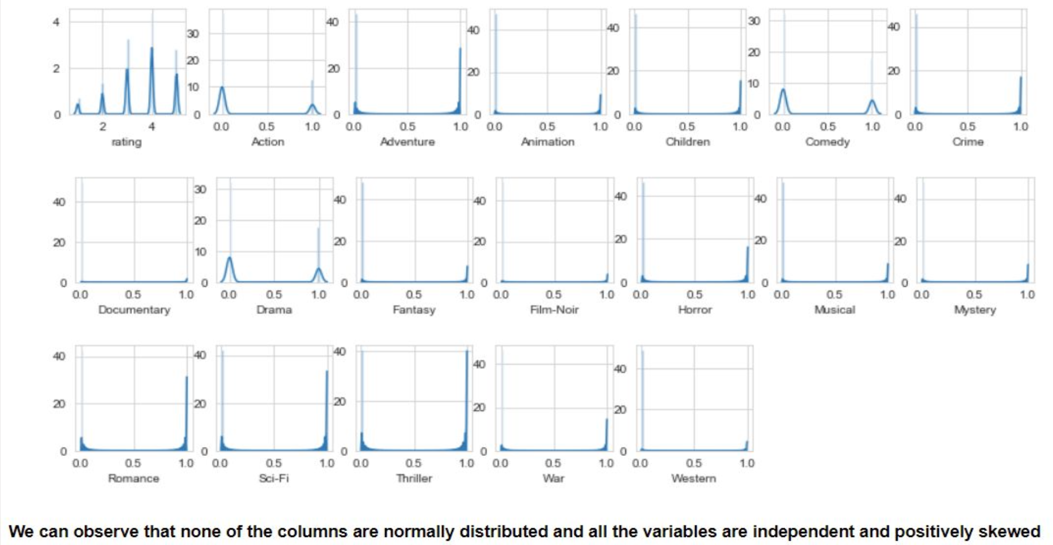
Exploratory Data Analysis-4

Slide 8
Evaluation Metrics
For als, knn, co-clustering and SVD,
For NEuRal Collaborative Reasoning
Prediction Evaluation
RMSE
MAE
Relevance
Precision
Recall
F-measure
NDCG
Prediction Evaluation
Pairwise contrastive loss
Relevance
Precision
Recall
F-measure
NDCG

Slide 9
Implementation: Alternating Least Squares (ALS)
Alternative Least Squares (ALS) is a matrix factorization algorithm that runs in parallel fashion and is built for large scale collaborative filtering problems .
ALS trains by minimizing two loss functions alternatively.
It first fixes the user matrix and runs gradient descent with item matrix.
It fixes the item matrix and runs gradient descent with user matrix.
ALS scales very well and does well with sparse datasets

Slide 10
Implementation: K-Nearest Neighbors
The KNN algorithm, a collaborative filtering algorithm, is based on a simple premise, that similar things are close to each other
It captures this idea of similarity by calculating cosine distances.
Used KNN Basic method from surprise package in our model

Slide 11
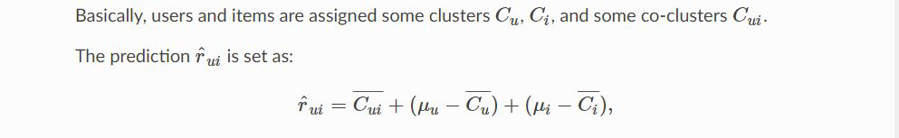
Implementation: CoClustering
Co-Clustering is a collaborative recommendation technique that given a matrix A seeks to cluster rows of A and columns of A at the same time.
Simultaneous clustering along the rows and columns of the utility matrix
Each user and item assigned to cluster and co-cluster
Final rating depends on the average rating of the user cluster and the movie cluster

Slide 12
Singular Vector Decomposition (SVD):-
Singular Value Decomposition is a collaborative recommendation engine technique for decomposing a matrix into three matrices which yield more information concerning the matrix data
V is an n×n orthogonal matrix
Used for dimensionality reduction, noise reduction and also compression
Σ is an diagonal m×n matrix
U is an m×m orthogonal matrix
A=UΣVT , where

Slide 13
Results
Model | Precision | Recall | F-Measure | nDCG | MAE | RMSE
SVD | 0.683 | 0.683 | 0.683 | 0.95 | 0.684 | 0.872
KNN | 0.677 | 0.677 | 0.677 | 0.735 | 0.705 | 0.894
CoClustering | 0.676 | 0.676 | 0.676 | 0.686 | 0.718 | 0.916
ALS | 0.651 | 0.651 | 0.651 | 0.712 | 0.681 | 0.872

Slide 14

Why NCR

Slide 15
NCR Workflow
Dataset Pre-processing and Logical Expressions Construction
NCR logical architecture and training
NCR evaluation

Slide 16
Dataset Processing
The ratings are transformed from the 1-5 scale to the 0-1 scale.
Ratings equal to or higher than 4 are converted into a positive feedback (1), while ratings lower than 4 are converted into a negative feedback (0).
Formalized the recommendation problem into a logical reasoning problem using propositional logic. Since propositional variables are boolean variables, we need to scale the ratings associated to the items in the 0-1 scale.
Next the ratings are grouped by user and ordered by timestamp.
For each user:
The first 5 positive ratings are kept in training set in order to reduce the cold-start problem.
The last positive rating is hold out for the test set.
The second to the last positive rating is hold out for the validation set.

Slide 17
Dataset Processing
If the user has less than 5 positive rating, all the ratings are kept in training set. If the user has only 6 positive ratings, 5 are kept in training set and the last one is used for test set. If the user has more than 6 positive ratings, the procedure explained before is used.
For each user built their train, validation, and test logical expressions. These logical expressions are then used to train and test the NCR model.
Logical expressions are built as follows:
for each positive item in the user historical information, we select the 5 most recent items that come just before that specific item as the history set of the logical expression.
then, built the logical expression using this template: (conjunction of items in the history set) -> selected positive item.

Slide 18
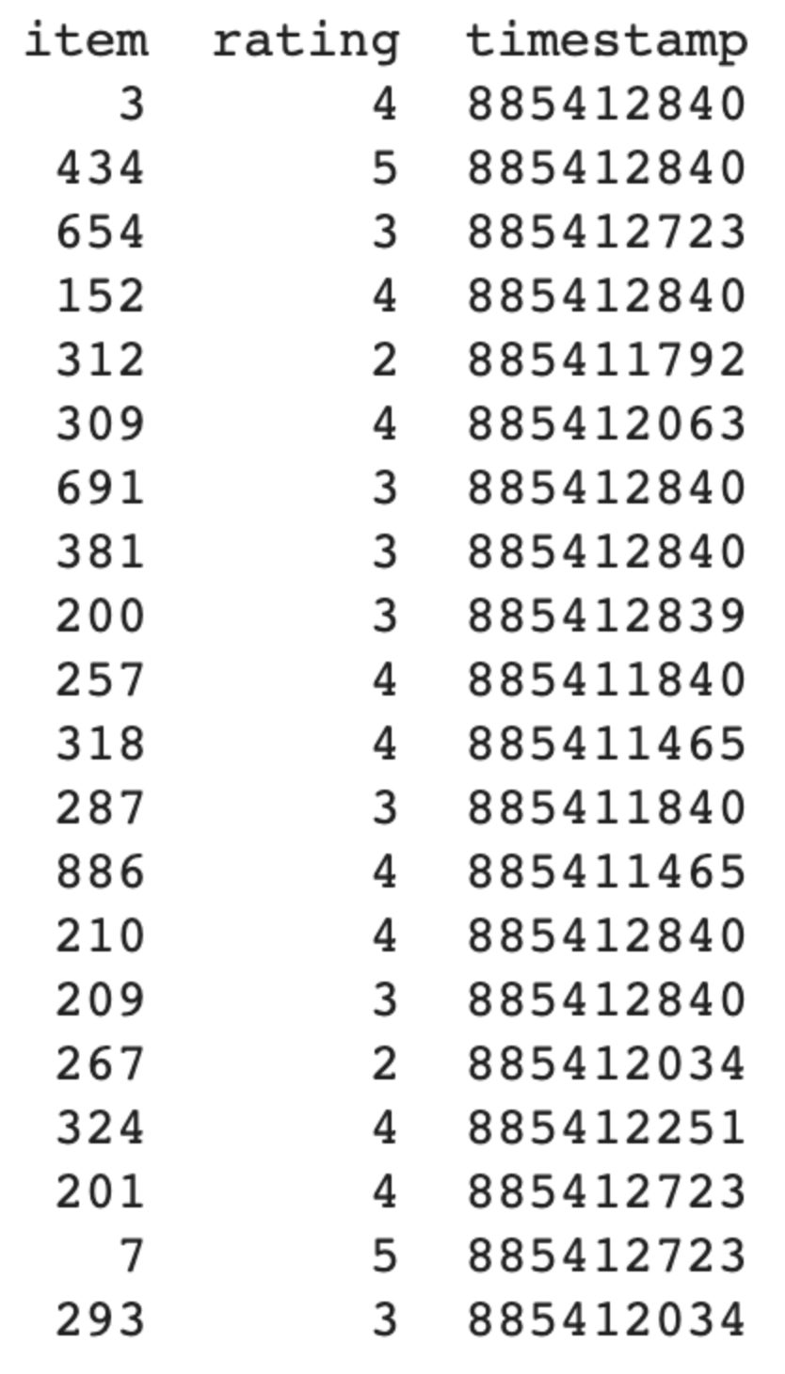
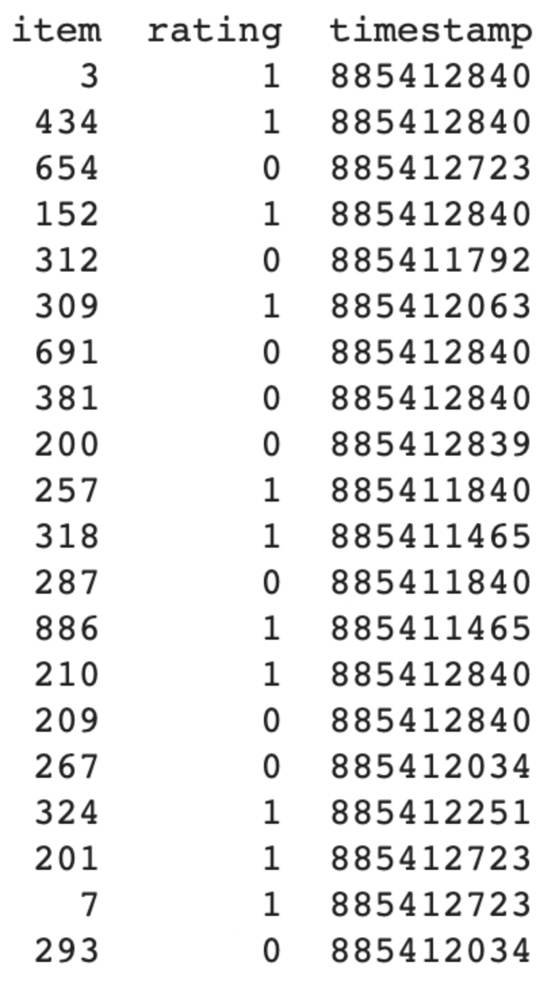
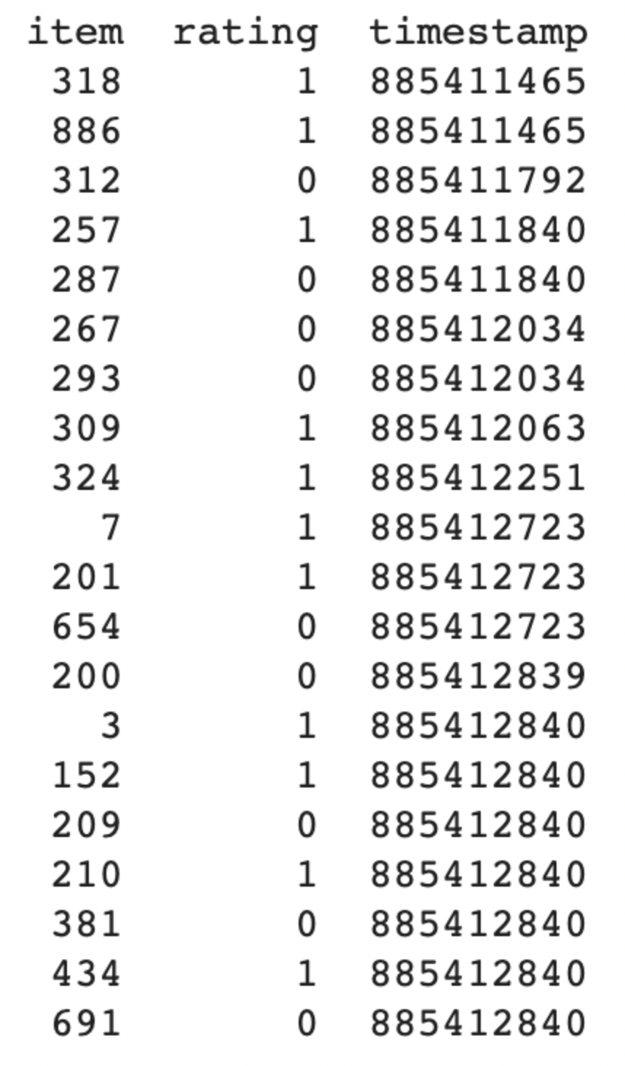
MovieLens Data Processing for NCR
MovieLens 100k dataset
User Ratings converted to 0-1 scale
Order the User Ratings by Timestamp

Slide 19
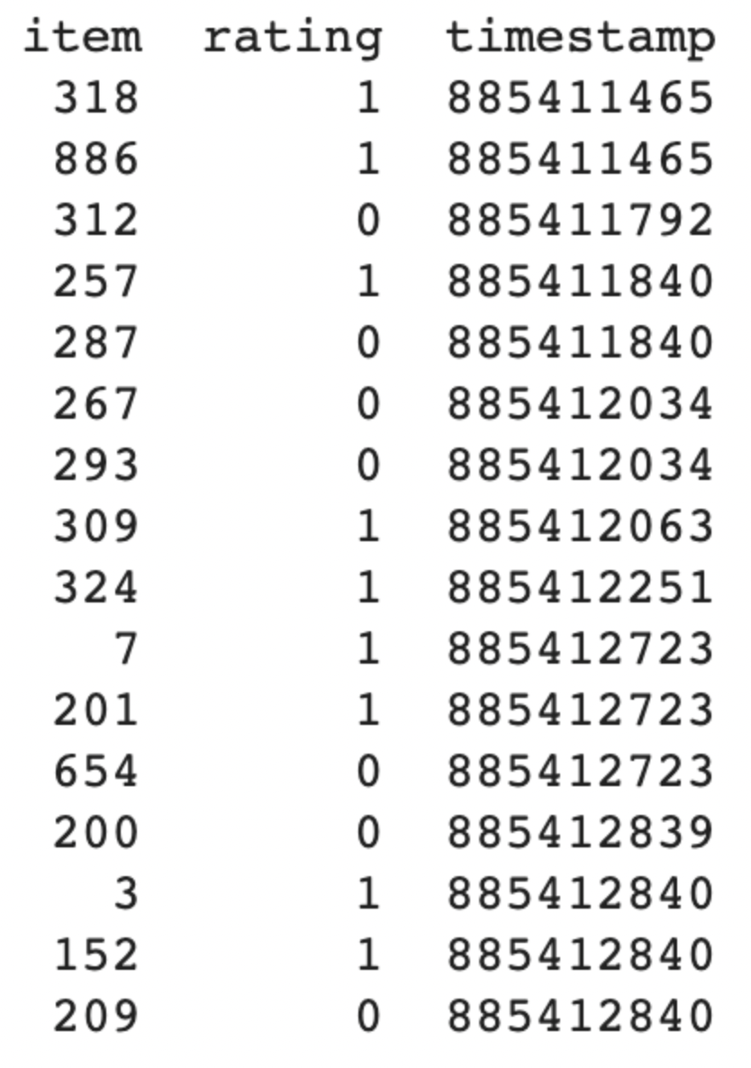
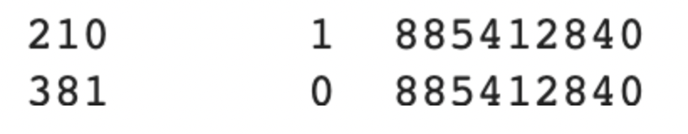
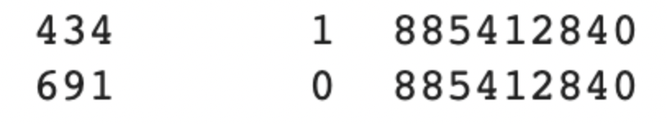
Train, Validation, and Test split
Validation set
Test set
Training set

Slide 20
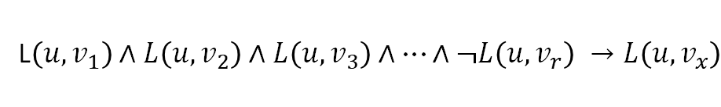
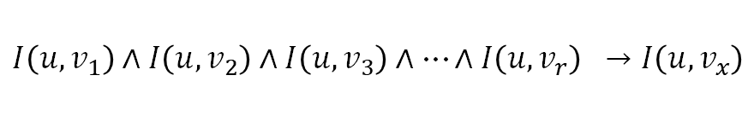
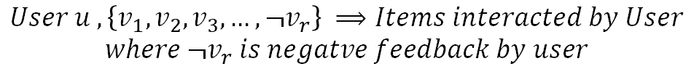
NCR Formalization
Horn Clause for Implicit Function
Conjunction form of Historical Interactions
Encoding Function that need to be learned (also called Predicate Function)
User u has interacted with item vi
$$I\left(u,v_{1}\right)∧I\left(u,v_{2}\right)∧I\left(u,v_{3}\right)∧…∧I\left(u,v_{r}\right) →I\left(u,v_{x}\right)$$
Target Interaction that we want to Predict
$$User u , \left\{v_{1},v_{2},v_{3},…,v_{r}\right\} ⟹Items interacted by User$$
Horn Clause for Explicit Function
L$\left(u,v_{1}\right)∧L\left(u,v_{2}\right)∧L\left(u,v_{3}\right)∧…∧¬L\left(u,v_{r}\right) →L\left(u,v_{x}\right)$
$$User u , \left\{v_{1},v_{2},v_{3},…,¬v_{r}\right\} ⟹Items interacted by User$$
$$where ¬v_{r} is negatve feedback by user$$

Slide 21
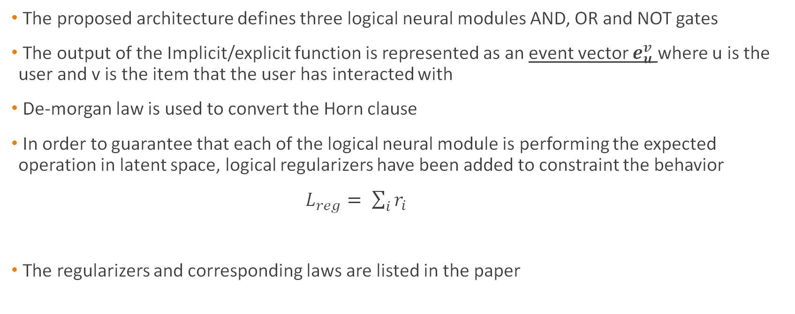
Implementation: NCR Architecture and Training 1
The proposed architecture defines three logical neural modules AND, OR and NOT gates
The output of the Implicit/explicit function is represented as an event vector $e_{u}^{v}$ where u is the user and v is the item that the user has interacted with
De-morgan law is used to convert the Horn clause
In order to guarantee that each of the logical neural module is performing the expected operation in latent space, logical regularizers have been added to constraint the behavior
$L_{reg}= \sum_{i}{r_{i}}$
The regularizers and corresponding laws are listed in the paper

Slide 22
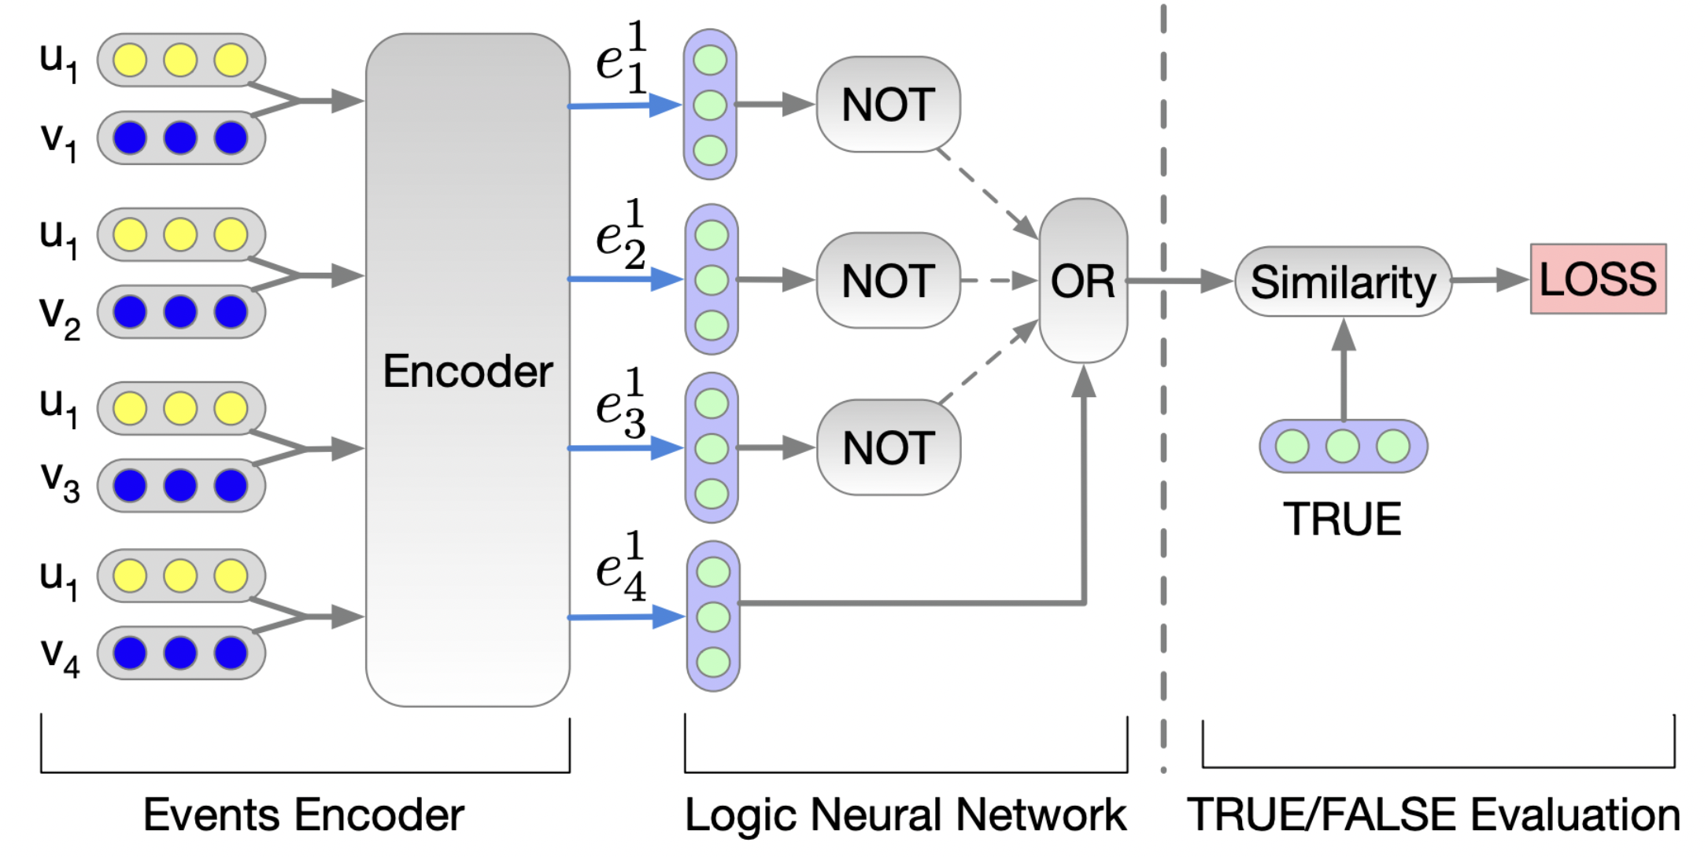
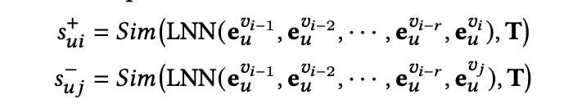
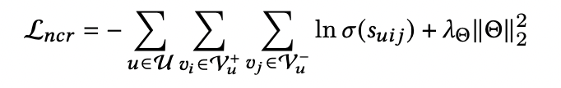
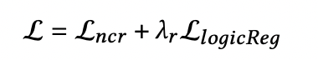
Implementation: NCR logical architecture and Training 2
The goal of NCR is to embed logical expressions and logical propositional variables in a logical latent space, then use logical reasoning to deliver appropriate suggestions based on logical reasoning
We construct a negative logical expression for each logical expression in the training set. Instead of the target item on the right side of the implication, the negative logical expression has a randomly picked item from the collection of objects that the user never interacted with.

Slide 23
Experiments on number of premises
 | nDCG @5 | nDCG @10 | Precision@5 | Precision@10 | Recall @5 | Recall @10 | Fmeasure@5 | Fmeasure@10 | Loss
Model presented in the paper | 0.370 | 0.427 | 0.495 | 0.695 | 0.526 | 0.702 | 0.51 | 0.70 | 13.4
Logical Expression with 2 or more premise | 0.370 | 0.428 | 0.494 | 0.699 | 0.525 | 0.703 | 0.509 | 0.701 | 14.1
Logical Expression with exactly 5 premise | 0.370 | 0.423 | 0.493 | 0.604 | 0.526 | 0.690 | 0.50 | 0.644 | 13.3
Excluding Double Negations | 0.362 | 0.417 | 0.496 | 0.594 | 0.517 | 0.689 | 0.506 | 0.638 | 16.3

Slide 24
Experiment with Embedding size
 | nDCG @5 | nDCG @10 | Precision @5 | Precision@10 | Recall @5 | Recall @10 | Fmeasure@5 | Fmeasure@10 | Loss
Embedding Size 32 | 0.350 | 0.406 | 0.495 | 0.592 | 0.501 | 0.674 | 0.50 | 0.63 | 16.8
Embedding Size 64 | 0.370 | 0.427 | 0.497 | 0.674 | 0.526 | 0.702 | 0.511 | 0.687 | 15.5
Embedding Size 128 | 0.375 | 0.427 | 0.506 | 0.648 | 0.535 | 0.696 | 0.52 | 0.67 | 13.2
Embedding Size 256 | 0.374 | 0.430 | 0.496 | 0.594 | 0.534 | 0.706 | 0.514 | 0.645 | 14.5

Slide 25
Experiments with L2 Regularization
​ | Ndcg@5​ | Ndcg@10​ | Precision@5​ | Precision@10​ | Recall@5​ | Recall@10​ | Fmeasure@5​ | Fmeasure@10​ | Loss​
L2 Decrease | ​0.365 | ​0.421 | 0.495 | 0.495 | ​0.513 | ​0.688 | 0.503 | 0.576 | ​14.3
Full Model | 0.370 | 0.427 | 0.497 | 0.494 | 0.526 | 0.702 | 0.511 | 0.58 | ​15.5
​L2 Increase | ​0.361 | ​0.416 | 0.506 | 0.504 | ​0.512 | ​0.685 | 0.509 | 0.581 | ​17.0

Slide 26
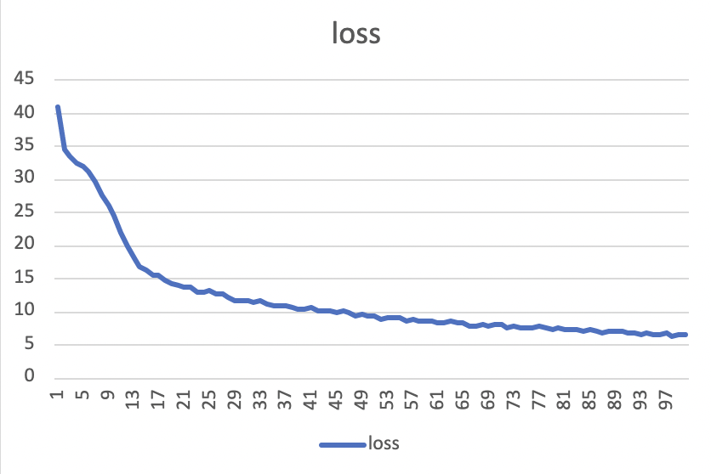
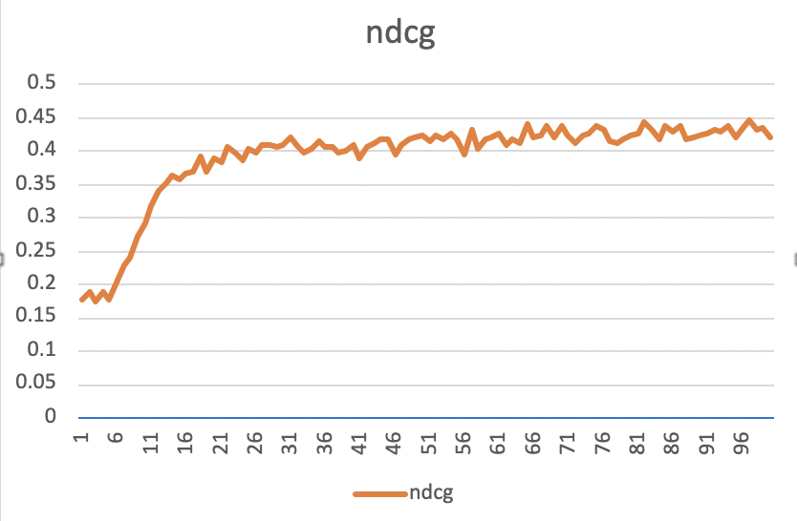
Loss and nDCG Graphs

Slide 27
Appendix

